Slide 1


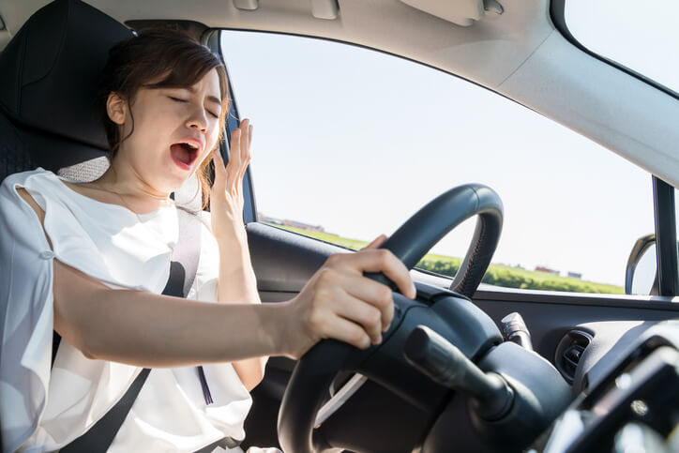
RAJ KUMAR GOEL INSTITUTE OF TECHNOLOGY GHAZIABAD
B.TECH IN COMPUTER SCIENCE ENGINEERING
SESSION:-2020-2021
DRIVER DROWSINESS DETECTION
GUIDE NAME:DR. SACHI GUPTA
HOD CSE DEPARTMENT RKGIT
SUBMITTED BY:-G-8
1.PRINCY UPADHYAY(1703310139)
2.LAUREN JAIN(1703310102)
3.SATYA MISHRA(1703310176))
2.SHRIYA GOYAL(1703310195)

Slide 2
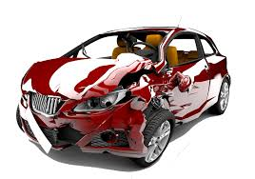
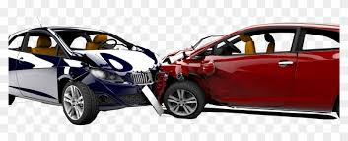
ROAD ACCIDENT RATE
INTRODUCTION
According to National Crime Records Bureau(NCRB) over 1,48,707 people were killed in road accidents.
Two wheelers account for 25% of total road crash deaths.
There is one death in every 4 minutes due to a road accident in India.
India ranks 1st in the number of road accidents.

Slide 3
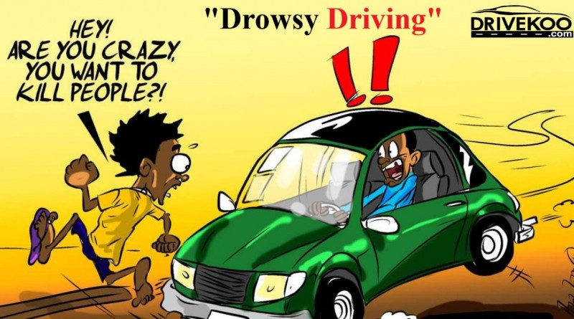
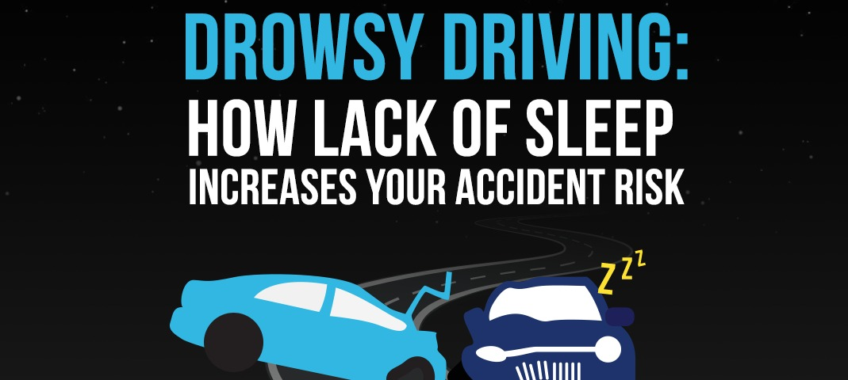
RATE OF ACCIDENTS DUE TO DROWSINESS
INTRODUCTION
ACCORDING TO NSF ABOUT 37% OR 103 MILLION PEOPLE HAVE FALLEN ASLEEP AT THE WHEEL.
21% OF ALL FATAL ACCIDENTS ARE DUE TO DROWSY DRIVING.
NATIONAL HIGHWAY TRAFFIC SAFETY ADMINISTRATION ESTIMATES THAT 100,000 ACCIDENTS ARE DIRECT RESULT OF DRIVER FATIQUE EVERY YEAR.

Slide 4
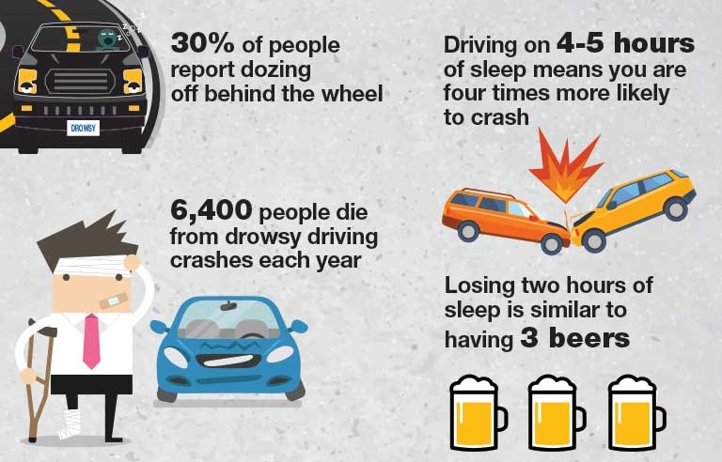
REASON FOR DEVELOPING THIS PROJECT
INTRODUCTION

Slide 5
LITERATURE SURVEY
Technique 1-Vehicle Based Measures:-These measurements are determined in a simulated environment by placing sensors on various vehicle components, such as the steering wheel and the acceleration pedal.
Technique 2-Physiological Measures:-The correlation between physiological signals electrocardiogram (ECG), Electromyogram (EMG), Electrooculogram(EoG) and electroencephalogram (EEG)) and driver drowsiness has been studied by many researchers.
Technique 3-Subjective Measures :-Subjective measures are those which evaluate the level of drowsiness based on the driver’s personal estimation.
Technique 4-Behavioral Measures :-The behaviour of the driver, including yawning, eye closure, eye blinking, head pose, etc., is monitored through a camera and the driver gets alert if any of these drowsiness symptoms are detected

Slide 6
INFERENCES DRAWN OUT FROM LITERATURE SURVEY
Technique 1-Vehicle Based Measures:-
Advantages - Non intrusive.
Disadvantages– Unreliable.
Technique 2-Physiological Measures:-
Advantages - Reliable, Accurate.
Disadvantages– Intrusive.
Technique 3-Subjective Measures:-
Advantages - Subjective .
Disadvantages– Not possible in real time.
Technique 4-Behavioral Measures:-
Advantages –Reliable, Accurate.
Disadvantages– Lighting condition Background.

Slide 7
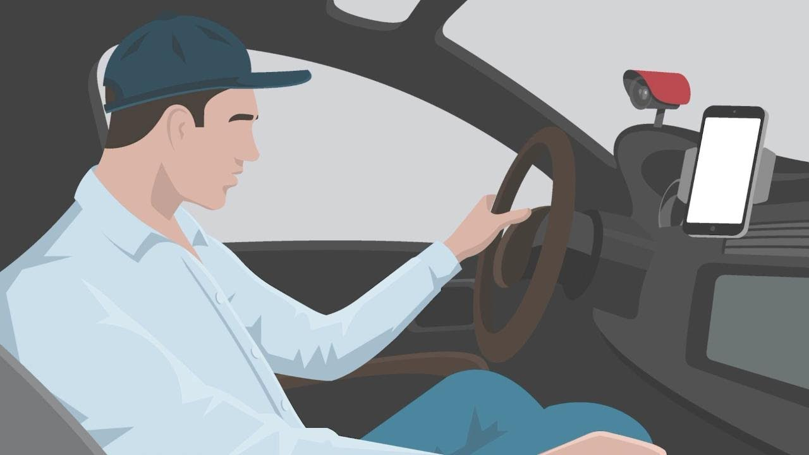
Objective and scope of project
Our objective of the project is to ensure the safety system and to avoid accidents.
Objective
This project can be integrated with external camera in car, so that we can automatically detect driver's face.
Scope

Slide 8
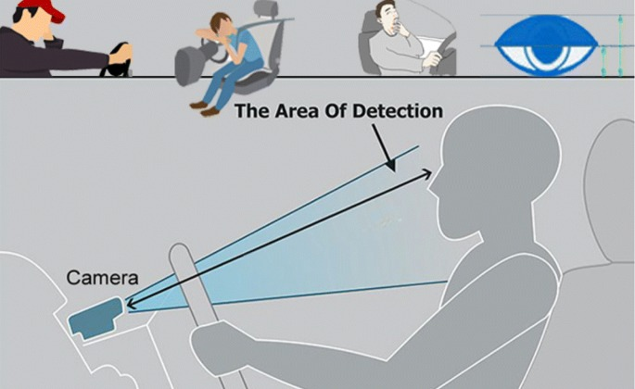
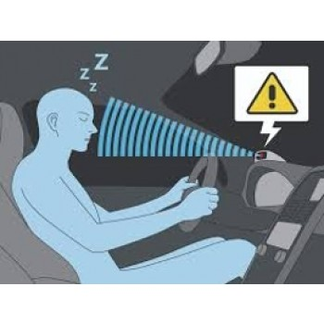
PROBLEM STATEMENT
Design a prototype Driver Drowsiness Detection System using Computer vision.

Slide 9
SOLUTION/METHODOLOGY
Video Input
Dividing video into frames
Fetch Frame
Face Detection
Feature Extraction
Eye State
Mouth State
Eye closure and blinking Ratio
Mouth Opening and closure
Is it a Drowsy state?
NO
Yes
Warning

Slide 10
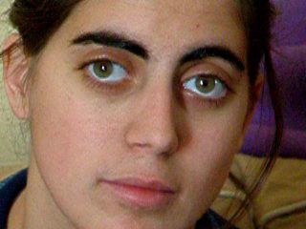
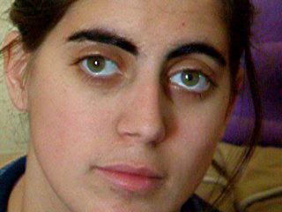
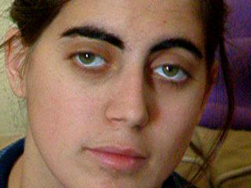
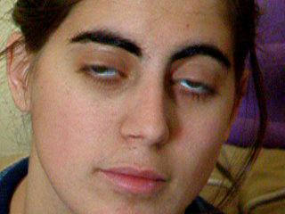
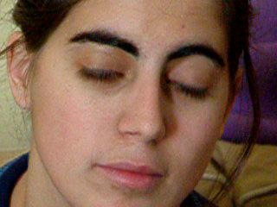
Implementation – Step (1)
frames
per second

Slide 11
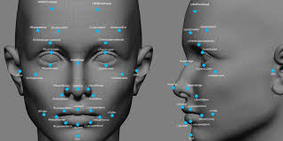
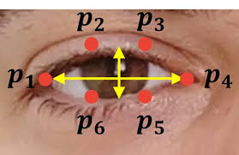
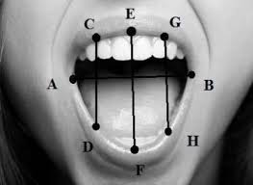
Implementation – Step (2)
Implementation – Step (3)
Implementation – Step (4)

Slide 12
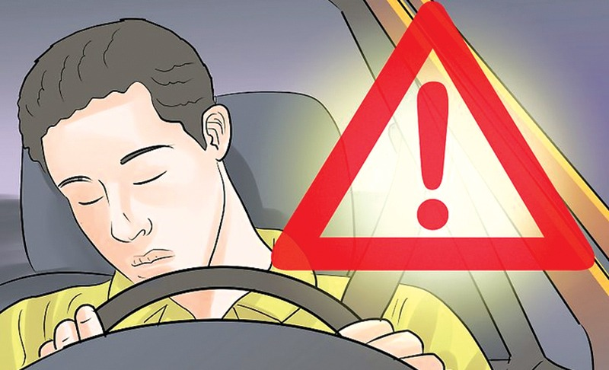

Implementation – Step (5)
Implementation – Step (6)

Slide 13

INNOVATIVE FEATURES OF THE PROJECT
The location of the driver will be sent to his / her near and dear one so that in case of any accident with the driver, the person near and dear to him will come to know about the driver on time.
The alarm warning will be deactivated manually rather than automatically. This will ensure the driver's activation as until he sets off the alarm, the alarm will not go off

Slide 14
References
].Zahra Mardi, Seyedeh Naghmeh Miri Ashtiani, Mohammad Mikaili. EEG-based Drowsiness Detection for Safe Driving Using Chaotic Features and Statistical Tests, Zahra Mardi. May-Aug, 2011;
https://www.ncbi.nlm.nih.gov/pmc/articles/PMC3342623/
[2].JarekKrajewski, David Sommer, UdoTrutschel, Dave Edwards, Martin Golz[. Steering Wheel Behavior Based Estimation of Fatigue. June, 2009; https://ir.uiowa.edu/cgi/viewcontent.cgi?article=1311&context=drivingassessme nt [3].RatebJabbar∗†, Mohammed Shinoy∗ , Mohamed Kharbeche∗ , Khalifa AlKhalifa§ , MoezKrichen‡ , KamelBarkaoui†. Driver Drowsiness Detection Model Using Convolutional Neural Networks Techniques for Android Application. Jan, 2020; https://arxiv.org/pdf/2002.03728.pdf
[4].SayaniGhosh, T. Nandy, Nilotpal Manna. Real Time Eye Detection and Tracking Method for Driver Assistance System. 2015;
https://www.semanticscholar.org/paper/Real-Time-Eye-Detection-and-TrackingMethod-for-Ghosh-Nandy/6d4407b102766cef693c873f4ce37bb19b58bb8c

Slide 15
THANK YOU

